Slide 1
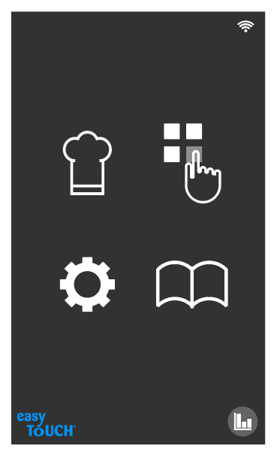
START UP PAGE
Manual Cook Mode /
Recipe Creation
Press N Go / Favourites
Settings
All Recipes / Master Cookbook
Diagnostics

Slide 2
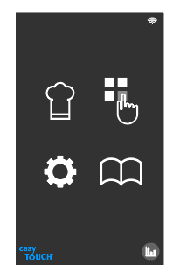
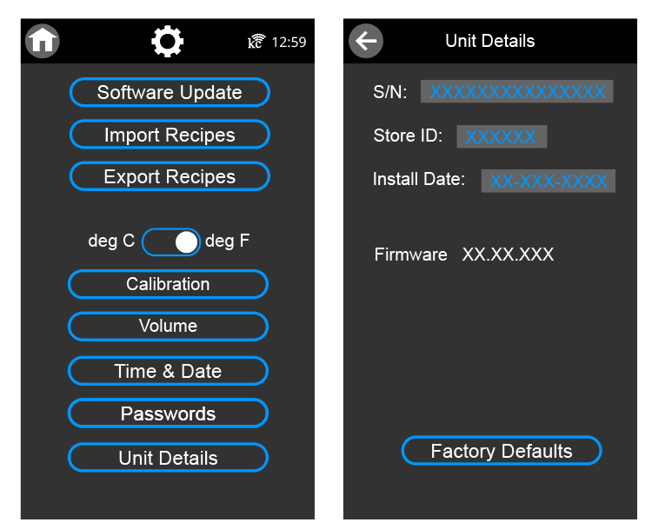
Settings Examples
Entering setting would be PASSWORD protected
A 2 or 3 tier system may be required:
ENGINEERING
TECHNICIAN
STORE

Slide 3
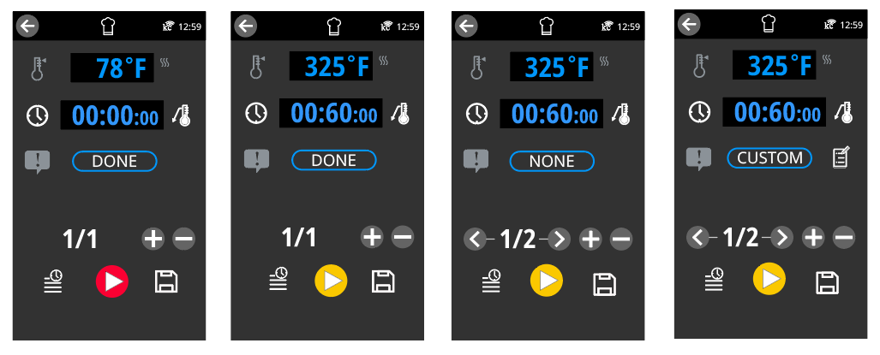
Single Timer Recipe Creation 1 of 2
When CUSTOM prompt is selected, an TEXT EDIT icon appears allowing for the custom prompt to be created
When second stage added is added, the default DONE prompt for stage 1 will automatically default to NONE and the default stage 2 prompt will be DONE
Press icon to toggle between DONE, NONE and CUSTOM and then loop back to NONE if pressed again for Prompt Setting
DONE is default
YELLOW “PLAY” button indicates that the unit will have to preheat before timer can start now that a higher temp has been entered
Press “+” icon to add a stage or “-” to delete a stage
Press icon to switch to multi timer mode if desired
RED “PLAY” button because no time has been entered

Slide 4
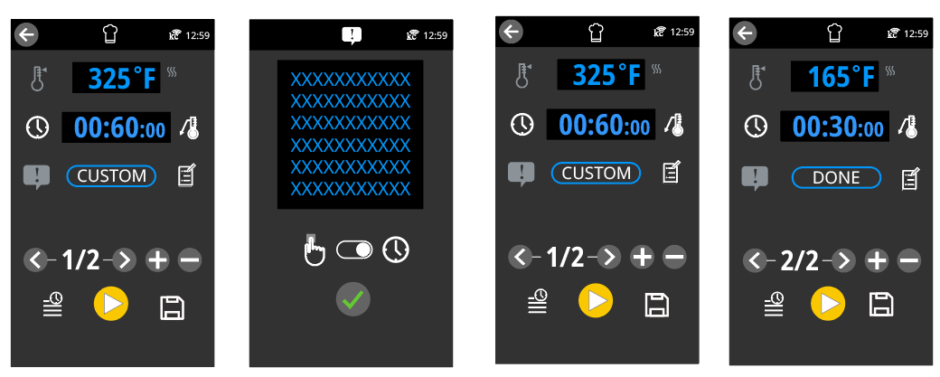
Single Timer Recipe Creation 2 of 2
Toggle between the acknowledgment mode for the prompt: “finger icon” means the user must acknowledge the prompt to clear it from the screen; “timer icon” means the prompt will clear itself after a sett amount of time (amount of time can be changed in SETTINGS)
Select text box and use pop up keyboard to create the desired prompt text
Press icon create or edit the custom prompt
When finished press the green arrow
Press “>” icon to go to next stage
Press to start manual cooking
Press to save recipe

Slide 5
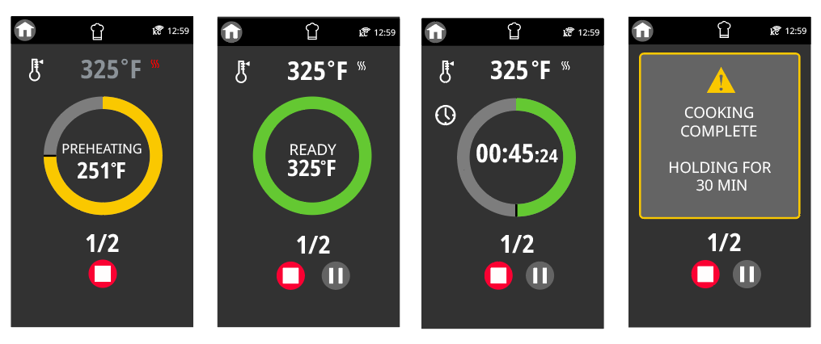
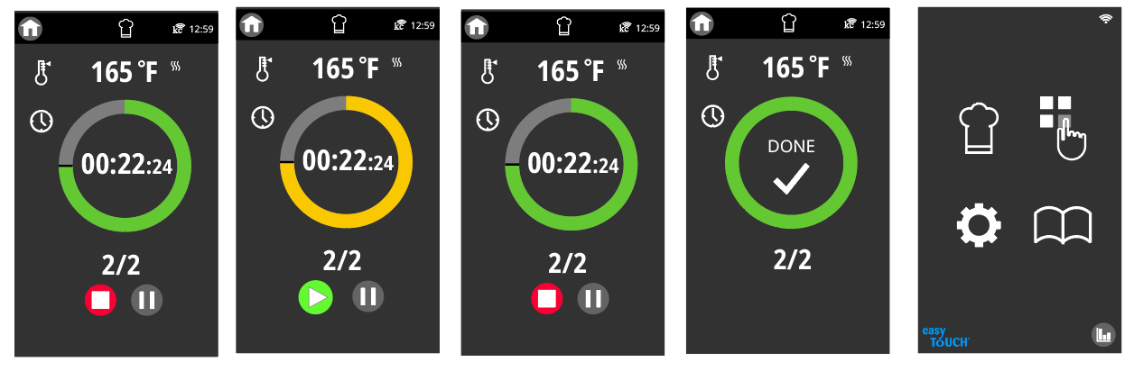
Single Timer Recipe Cooking
The timer and graphic represent the TOTAL cook time (not just the stage time)
AN example of a SELF CLEARING custom prompt… there is no acknowledgement icon to press
If the STOP button is pressed during preheat, the grill will turn OFF and go to HOME screen
If the PAUSE button is pressed during a single timer recipe, the countdown timer will simply pause until the PLAY button is pressed; the YELLOW colour is used to visually signal that the timer is no longer counting down
Note unit turns OFF and goes back to home screen once all timers have expired and have bene acknowledged

Slide 6
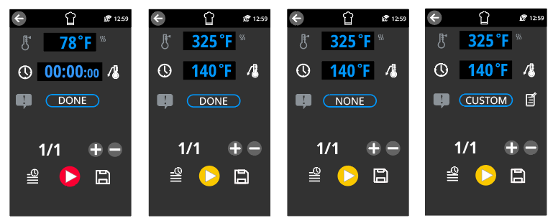
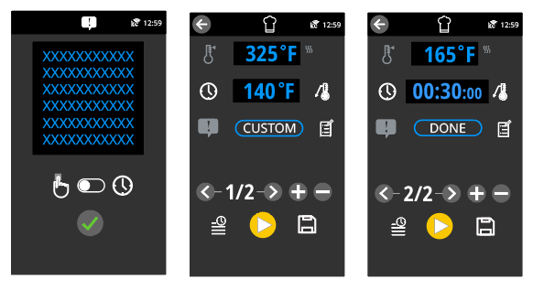
Probe Recipe Creation
Press icon to toggle to PROBE COOKING mode
Toggle between the acknowledgment mode for the prompt: MANUAL means the user must acknowledge the prompt to clear it from the screen; Self Clear means the prompt will clear itself after a settable amount of time
In this example, a second timed holding stage has been added to the recipe

Slide 7
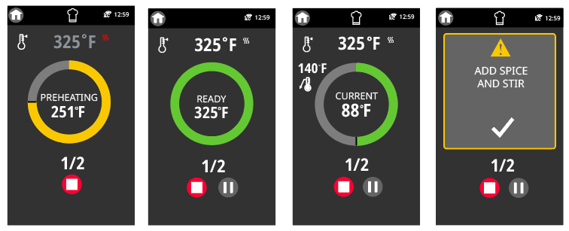
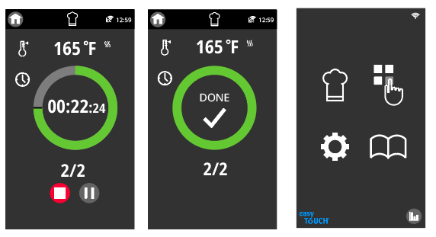
Probe Recipe Cooking
When probe cooking, the graphic represents delta to the desired probe temperature
AN example of a MANUAL acknowledgement custom prompt… the check mark must be pressed to clear this prompt (but all timers continue to work in the background)
Note unit turns OFF and goes back to home screen once all timers have expired and have bene acknowledged

Slide 8
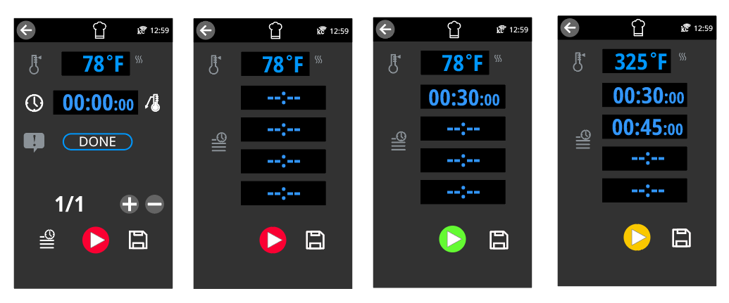
Multiple Timer Recipe Creation
Go back to exit mode if desired
Press icon to go into Multi Tray mode
RED “PLAY” button because timer has not been set
RED “PLAY” button because no timers have been set (note this is not considered INFINITY MODE)
YELLOW “PLAY” button indicates that the unit will have to preheat before timer can start now that a higher temp has been entered

Slide 9
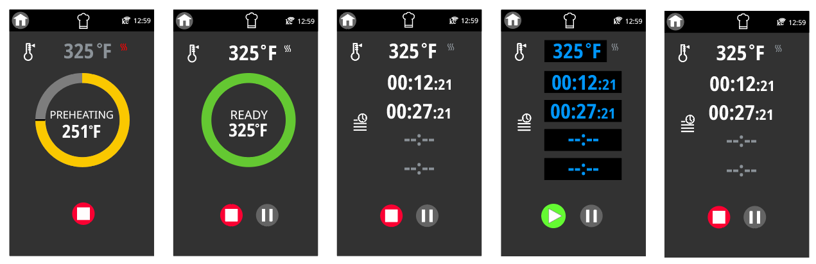
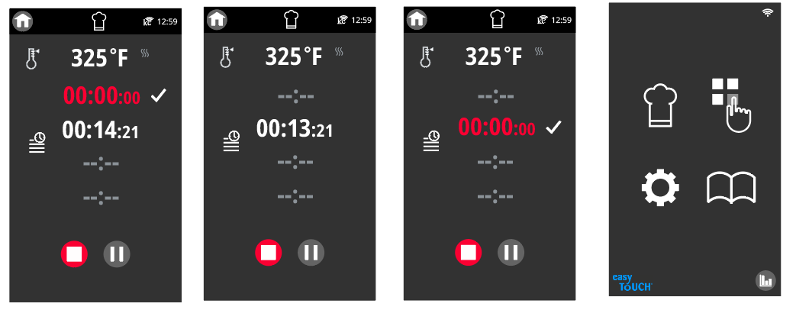
Multiple Timer Recipe Cooking
Pressing PAUSE would let you change temp or add/modify timers
Pressing PLAY after changes are made to resume
Note unit turns OFF and goes back to home screen once all timers have expired and have bene acknowledged

Slide 10
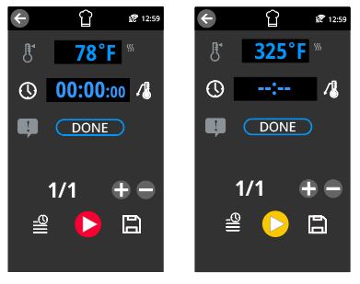
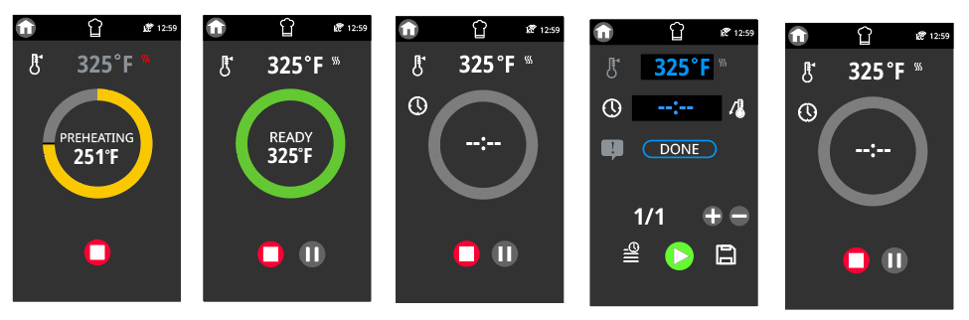
Cooking with INFINITY Mode
Usual default screen when manual cooking is selected
Use the number pad and select “--:--” from keypad to use INFINITY mode
Press PLAY to preheat grill
The grey graphic is used to show that there is no countdown underway
Pressing PAUSE while in INFINITY mode will let you set a timer if you want… pressing PLAY without making a change will resume infinity mode as illustrated here

Slide 11
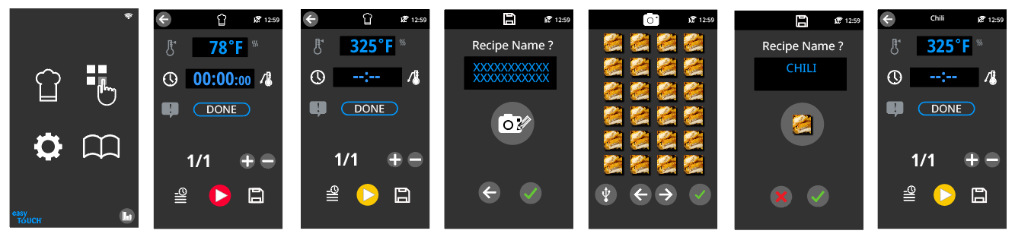
Saving a Recipe
Press in text box and use keypad to enter a recipe name
Press icon to go to saved photos to select an image for the recipe
Select a photo from the ones saved using <> to switch between pages of saved icons, or press the USB icon to upload a new image from a USB; Press checkmark when finished
Accept the recipe and save or select cancel if desired to exit
Return to screen where you can press PLAY and begin cooking
Press SAVE

Slide 12
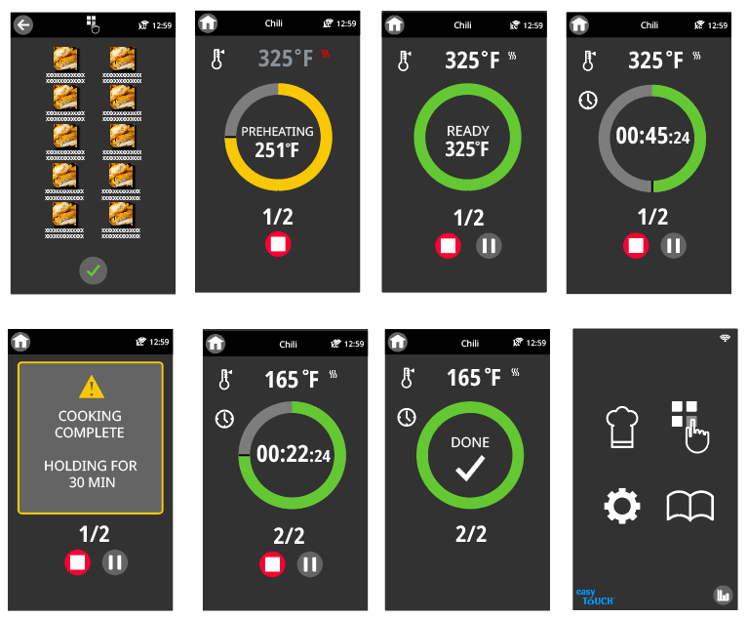
Cooking using a previously SAVED recipe or FAVOURITE
Select a recipe from the list of favourites and confirm choice
Press “Press N Go” Icon
Note unit turns OFF and goes back to home screen once all timers have expired and have bene acknowledged

Slide 13
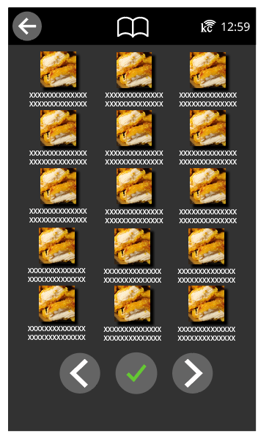
Cooking using a previously SAVED recipe within the COOKBOOK
Select a recipe from the list of favourites and confirm choice
Press Cookbook icon to access all recipes that have been saved
Can use left and right arrows to change between pages and
Press green checkmark to start recipe

